Slide 1
Interest Rates, Cash Flow and Equivalence

Slide 2
Time Value of Money (TVM)
Description: TVM explains the change in the amount of money over time for funds owed by or owned by a corporation (or individual)
Corporate investments are expected to earn a return
Investment involves money
Money has a ‘time value’
The time value of money is the most important concept in engineering economy

Slide 3
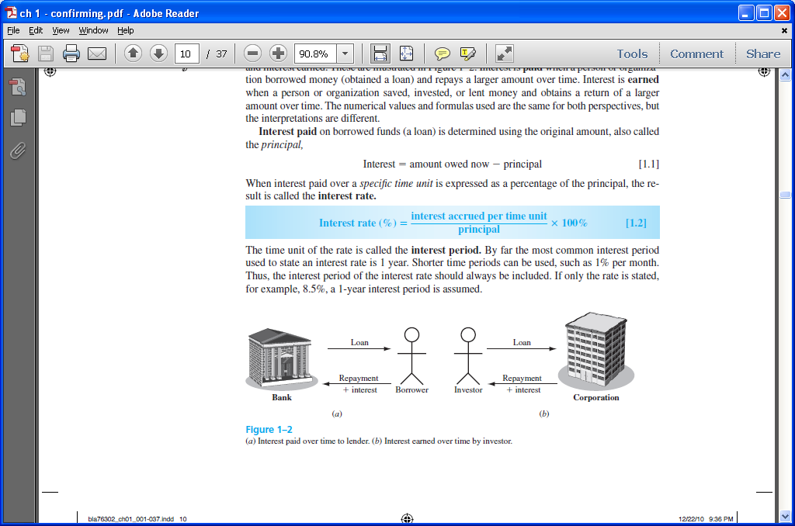
Interest and Interest Rate
Interest – the manifestation of the time value of money
Fee that one pays to use someone else’s money
Difference between an ending amount of money and a beginning amount of money
Interest = amount owed now – principal
Interest rate – Interest paid over a time period expressed as a percentage of principal

Slide 4
Rate of Return
Interest earned over a period of time is expressed as a percentage of the original amount (principal)
Borrower’s perspective – interest rate paid
Lender’s or investor’s perspective – rate of return earned

Slide 5
Interest paid Interest earned
Interest rate
Rate of return

Slide 6
Commonly used Symbols
t = time, usually in periods such as years or months
P = value or amount of money at a time t designated as present or time 0
F = value or amount of money at some future time, such as at t = n periods in the future
A = series of consecutive, equal, end-of-period amounts of money
n = number of interest periods; years, months
i = interest rate or rate of return per time period; percent per year or month

Slide 7
Cash Flows: Terms
Cash Inflows – Revenues (R), receipts, incomes, savings generated by projects and activities that flow in. Plus sign used
Cash Outflows – Disbursements (D), costs, expenses, taxes caused by projects and activities that flow out. Minus sign used
Net Cash Flow (NCF) for each time period:
NCF = cash inflows – cash outflows = R – D
End-of-period assumption:
Funds flow at the end of a given interest period

Slide 8
Cash Flows: Estimating
Point estimate – A single-value estimate of a cash flow element of an alternative
Cash inflow: Income = $150,000 per month
Range estimate – Min and max values that estimate the cash flow
Cash outflow: Cost is between $2.5 M and $3.2 M
Point estimates are commonly used; however, range estimates with probabilities attached provide a better understanding of variability of economic parameters used to make decisions

Slide 9
Cash Flow Diagrams
What a typical cash flow diagram might look like
Draw a time line
Always assume end-of-period cash flows
Time
0 1 2 … … … n - 1 n
One time period
F = $100
Show the cash flows (to approximate scale)
0 1 2 … … … n-1 n
Cash flows are shown as directed arrows: + (up) for inflow
- (down) for outflow
P = $-80

Slide 10
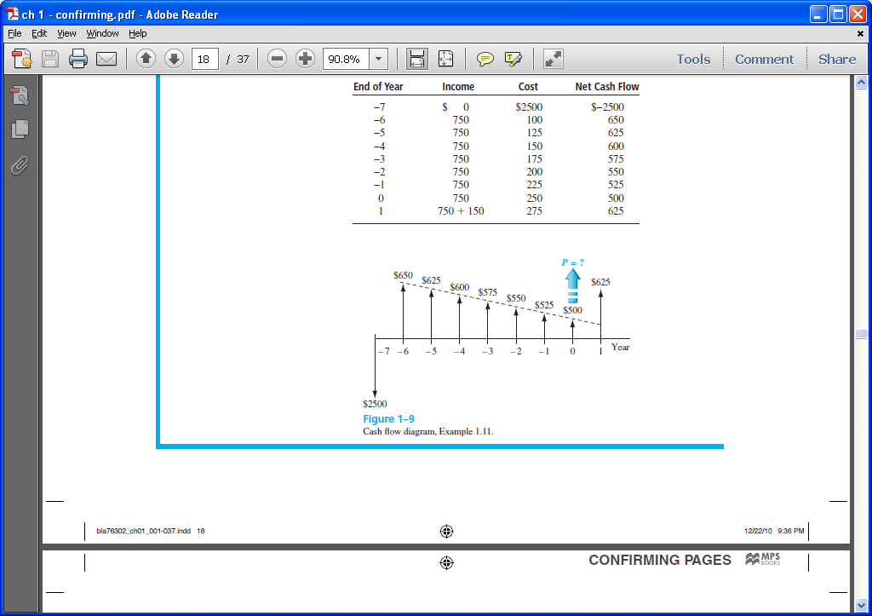
Cash Flow Diagram Example
Plot observed cash flows over last 8 years and estimated sale next year for $150. Show present worth (P) arrow at present time, t = 0

Slide 11
Economic Equivalence
Definition: Combination of interest rate (rate of return) and time value of money to determine different amounts of money at different points in time that are economically equivalent
How it works: Use rate i and time t in upcoming relations to move money (values of P, F and A) between time points t = 0, 1, …, n to make them equivalent (not equal) at the rate i

Slide 12
Example of Equivalence
Different sums of money at different times may be equal in economic value at a given rate
$110
Year
0 1
Rate of return = 10% per year
$100 now
$100 now is economically equivalent to $110 one year from now, if the $100 is invested at a rate of 10% per year.

Slide 13
Simple and Compound Interest
Simple Interest
Interest is calculated using principal only
Interest = (principal)(number of periods)(interest rate)
I = Pni
Example: $100,000 lent for 3 years at simple i = 10% per year. What is repayment after 3 years?
Interest = 100,000(3)(0.10) = $30,000
Total due = 100,000 + 30,000 = $130,000

Slide 14
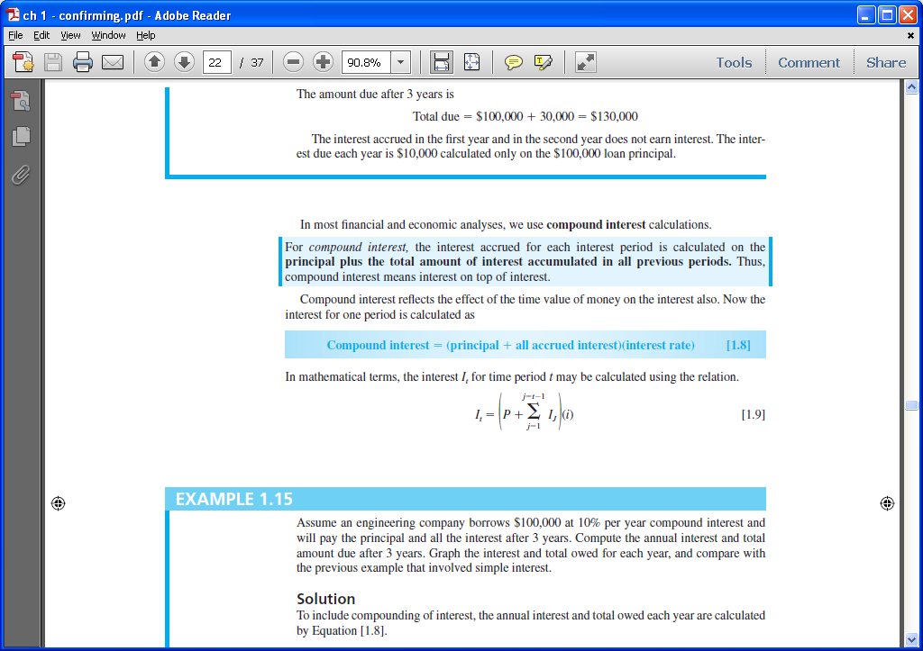
Simple and Compound Interest
Compound Interest
Interest is based on principal plus all accrued interest
That is, interest compounds over time
Interest = (principal + all accrued interest) (interest rate)
Interest for time period t is

Slide 15
Compound Interest Example
Example: $100,000 lent for 3 years at i = 10% per year compounded. What is repayment after 3 years?
Interest, year 1: I₁ = 100,000(0.10) = $10,000
Total due, year 1: T₁ = 100,000 + 10,000 = $110,000
Interest, year 2: I₂ = 110,000(0.10) = $11,000
Total due, year 2: T₂ = 110,000 + 11,000 = $121,000
Interest, year 3: I₃ = 121,000(0.10) = $12,100
Total due, year 3: T₃ = 121,000 + 12,100 = $133,100
Compounded: $133,100 Simple: $130,000

